Slide 1
AIR POLLUTION MONITORING AND ALERT SYSTEM PAVAN
GUIDED BY,
PROF. KALPANA
DEPARTMENT OF INFORMATION TECHNOLOGY
AGILAN S 15EUIT003
FAHEEN FATHIMA B N 15EUIT030
HARISH RAJ 15EUIT036
HINDU SREENI 15EUIT040
KARTHIK U 15EUIT048

Slide 2
PROBLEM STATEMENT
Increase in pollution in recent years by manifold
Unawareness of the growing impact on pollution by the people
Increase in several pollutants level in air
Lack of monitoring system in localities where pollution is increasing
Lack of cheap integrated system to alert people of the increasing toxic level in air.

Slide 3
EXISTING SYSTEM
IDEAS USED
Sensor based pollution detection system in metropolitan cities
Costly sensor system to monitor the total air pollution
IOT based monitoring system to monitor the area with pollution.

Slide 4
EXISTING SYSTEM
ADVANTAGES
Detects the presence of toxic substance in air
Measures the amount of toxicity
Surveillance of the area for air pollution

Slide 5
EXISTING SYSTEM
DISADVANTAGES
It does not provide proper means for public to access the data
It does not provide the source of pollutants causing the pollution
Costly mechanism comparatively
It lacks interface with the sensors and front end

Slide 6
PROPOSED SYSTEM
Introducing PAVAN which is the combination of software and hardware that is used for sensing, processing and alerting the environment about the toxicity levels present in the air
Providing the data about the total pollutants and its sources for normal people.
Detecting the toxicity level in air and finding measures in reducing the total pollution in air.
Alerting the environmentalists about the rising dangers of air pollution.

Slide 7
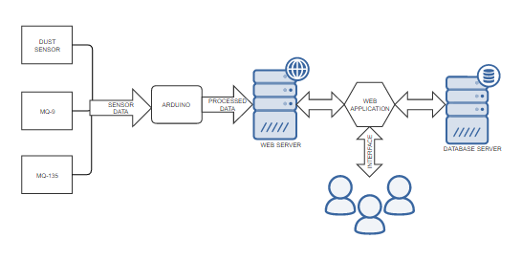
SYSTEM ARCHITECTURE

Slide 8
CONTEXT DIAGRAM

Slide 9
MODULES OF PROJECT
The major modules of the project include
Detecting toxic level (sensor)
Processing the toxicity level(arduino)
Correlating the source of pollutants
Storing the pollutant data(database server)

Slide 10
LITERATURE SURVEY

Slide 11
FEASIBLITY STUDY

Slide 12
REFERENCES
“Wireless sensor network based pollution monitoring system in metropolitan cities”,Shwetal Raipure, Deepak Mehetre. IEEE ICCSP2015 conference
“IOT-based Air Pollution Monitoring and Forecasting system”, Chen Xiaojun,Liu Xianpeng,Xu Peng, International Conference on Computer and Computational Sciences (ICCCS) 2015

Slide 13
REFERENCES
https://circuitdigest.com/microcontroller-projects/iot-air-pollution-monitoring-using-arduino
http://nevonprojects.com/iot-air-sound-pollution-monitoring-system/
https://www.aeroqual.com/outdoor-air-quality
https://plot.ly/arduino/air-quality-tutorial/
http://www.instructables.com/id/Air-Pollution-Detector/

